Slide 1
Logistic Regression
Adapted from: Tom Mitchell’s Machine Learning Book
Evan Wei Xiang and Qiang Yang

Slide 2
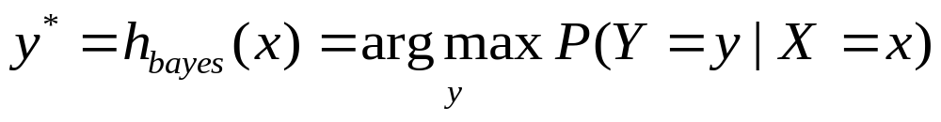
Classification
Learn: h:X->Y
  X – features
  Y – target classes
Suppose you know P(Y|X) exactly, how should you classify?
  Bayes classifier:
Why?

Slide 3
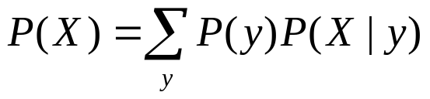
Generative vs. Discriminative
Classifiers - Intuition
Generative classifier, e.g., Naïve Bayes:
  Assume some functional form for P(X|Y), P(Y)
  Estimate parameters of P(X|Y), P(Y) directly from training data
  Use Bayes rule to calculate P(Y|X=x)
  This is ‘generative’ model
    Indirect computation of P(Y|X) through Bayes rule
    But, can generate a sample of the data,
Discriminative classifier, e.g., Logistic Regression:
  Assume some functional form for P(Y|X)
  Estimate parameters of P(Y|X) directly from training data
  This is the ‘discriminative’ model
    Directly learn P(Y|X)
    But cannot sample data, because P(X) is not available

Slide 4
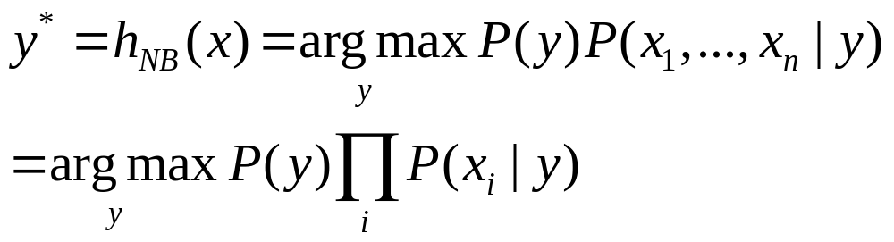
The Naïve Bayes Classifier
Given:
  Prior P(Y)
  n conditionally independent features X given the class Y
  For each Xi, we have likelihood P(X_{i}|Y)
Decision rule:
If assumption holds, NB is optimal classifier!

Slide 5
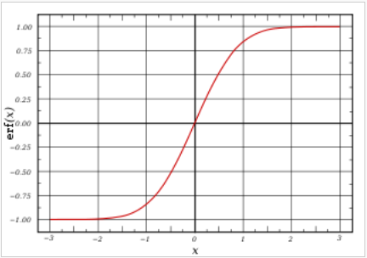
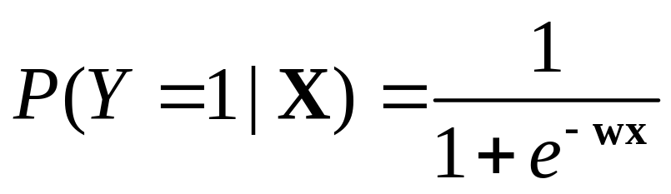
Logistic Regression
Let X be the data instance, and Y be the class label: Learn P(Y|X) directly
  Let W = (W1, W2, … Wn), X=(X1, X2, …, Xn), WX is the dot product
  Sigmoid function:

Slide 6
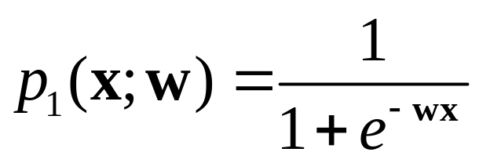
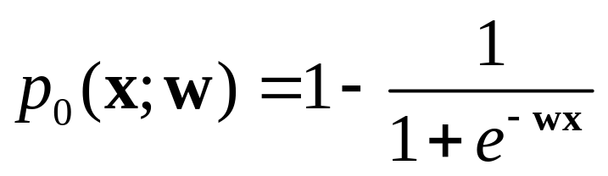
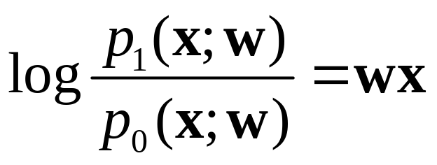
Logistic Regression
In logistic regression, we learn the conditional distribution P(y|x)
Let p_{y}(x;w) be our estimate of P(y|x), where w is a vector of adjustable parameters.
Assume there are two classes, y = 0 and y = 1 and
This is equivalent to
That is, the log odds of class 1 is a linear function of x
Q: How to find W?

Slide 7
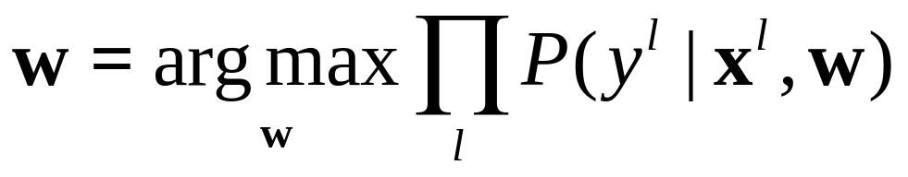
Constructing a Learning Algorithm
The conditional data likelihood is the probability of the observed Y values in the training data, conditioned on their corresponding X values. We choose parameters w that satisfy
where w = <w₀,w₁ ,…,w_{n}> is the vector of parameters to be estimated, y^{l} denotes the observed value of Y in the l th training example, and x^{l} denotes the observed value of X in the l th training example

Slide 8
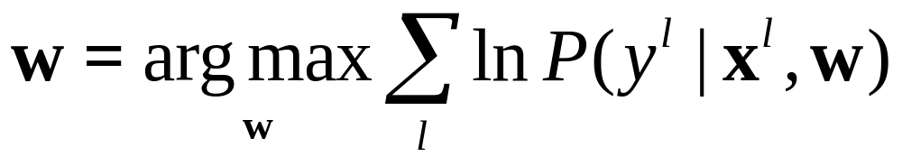
Constructing a Learning Algorithm
Equivalently, we can work with the log of the conditional likelihood:
This conditional data log likelihood, which we will denote l(W) can be written as
Note here we are utilizing the fact that Y can take only values 0 or 1, so only one of the two terms in the expression will be non-zero for any given y^{l}

Slide 9
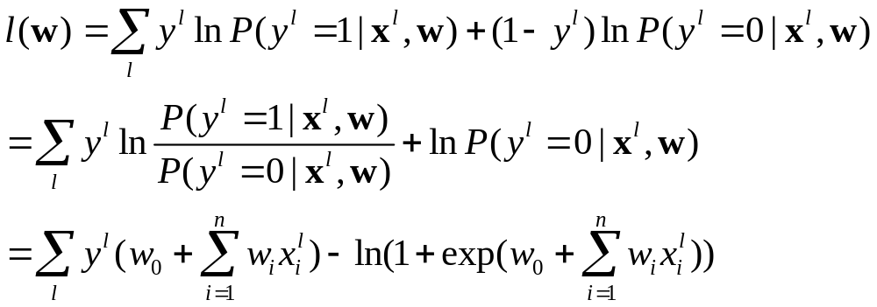
Computing the Likelihood
We can re-express the log of the conditional likelihood as:

Slide 10
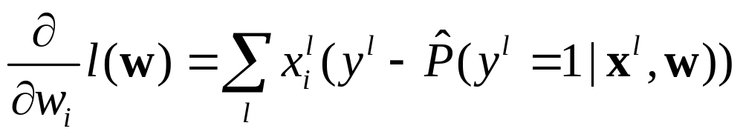
Fitting LR by Gradient Ascent
Unfortunately, there is no closed form solution to maximizing l(w) with respect to w. Therefore, one common approach is to use gradient ascent
The i th component of the vector gradient has the form
Logistic Regression prediction

Slide 11
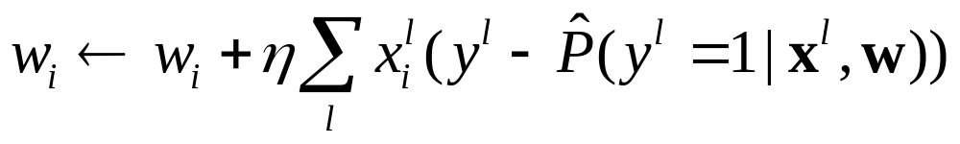
Fitting LR by Gradient Ascent
Given this formula for the derivative of each w_{i}, we can use standard gradient ascent to optimize the weights w. Beginning with initial weights of zero, we repeatedly update the weights in the direction of the gradient, changing the i th weight according to

Slide 12
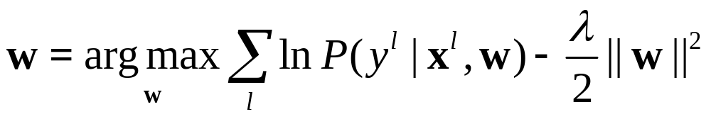
Regularization in Logistic Regression
Overﬁtting the training data is a problem that can arise in Logistic Regression, especially when data has very high dimensions and is sparse.
One approach to reducing overﬁtting is regularization, in which we create a modiﬁed “penalized log likelihood function,” which penalizes large values of w.

Slide 13
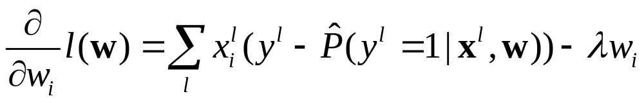
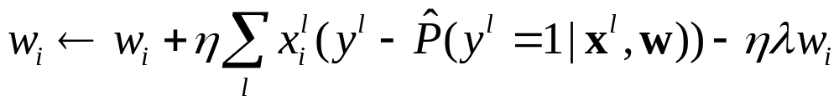
Regularization in Logistic Regression
The derivative of this penalized log likelihood function is similar to our earlier derivative, with one additional penalty term
which gives us the modiﬁed gradient descent rule

Slide 14
Summary of Logistic Regression
Learns the Conditional Probability Distribution P(y|x)
Local Search.
  Begins with initial weight vector.
  Modifies it iteratively to maximize an objective function.
  The objective function is the conditional log likelihood of the data – so the algorithm seeks the probability distribution P(y|x) that is most likely given the data.

Slide 15
What you should know LR
In general, NB and LR make different assumptions
  NB: Features independent given class -> assumption on P(X|Y)
  LR: Functional form of P(Y|X), no assumption on P(X|Y)
LR is a linear classifier
  decision rule is a hyperplane
LR optimized by conditional likelihood
  no closed-form solution
  concave -> global optimum with gradient ascent

